Slide 1
Keylogger
CAPSTONE PROJECT
Presented By:
1. Shrinivas U – Jeppiaar Institute of Technology – B.E CSE

Slide 2
OUTLINE
Problem Statement
Proposed System/Solution
System Development Approach
Algorithm & Deployment
Result (Output Image)
Conclusion
Future Scope
References

Slide 3
Problem Statement
Keyloggers are a particularly insidious type of spyware that can record and steal consecutive keystrokes (and much more) that the user enters on a device. The term keylogger, or “keystroke logger,” is self-explanatory: Software that logs what you type on your keyboard.
However, keyloggers can also enable cybercriminals to eavesdrop on you, watch you on your system camera, or listen over your smartphone’s microphone.
And they definitely do not own the device they infect. You don’t know they’ve breached your computer; and depending on what kind of keylogger it is, it can steal any passwords you’ve entered, periodically take screen shots, record the web pages you view, grab on to your sent emails and any instant messaging sessions, as well as sensitive financial information (such as credit card numbers, PIN codes, and bank accounts), and then send all that data over the network to a remote computer or web server. There, the person operating the logging program can retrieve it all, potentially sending it to third parties for criminal purposes.

Slide 4
Proposed Solution
Our proposed system entails the development of a keylogger using Python's Tkinter library for the GUI, alongside the pynput library for capturing keyboard inputs. The keylogger records keystrokes and saves them in both text and JSON formats for comprehensive analysis.

Slide 5
System Approach
System requirements:
Python: For programming the keylogger functionality.
Tkinter: For building the graphical user interface (GUI).
pynput: For capturing keyboard inputs.
JSON: For storing keystroke data in a structured format.

Slide 6
Algorithm & Deployment
Initialization: Initialize necessary variables and flags.
Event Handling:
on_press(key): Records pressed and held keys.
on_release(key): Records released keys and manages flag state.
Logging:
generate_text_log(key): Saves keystrokes in a text file.
generate_json_file(keys_used): Saves keystrokes in a JSON file.
Keylogger Control:
start_keylogger(): Initiates keylogging process.
stop_keylogger(): Stops keylogging.

Slide 7
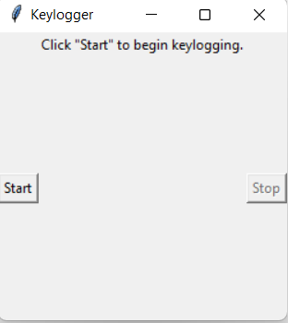
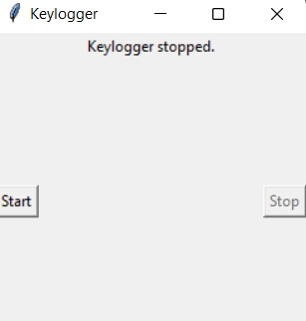
Result
A GUI appears when we execute the keylogger software. Upon pressing “start” the keylogger starts logging all the keystrokes in a text file and stops when we press “stop”.

Slide 8
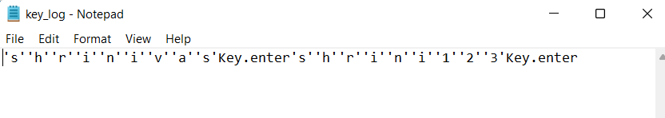

Slide 9
Conclusion
Implementing a keylogger highlights the ease of capturing keyboard inputs and underscores the importance of robust security measures to prevent unauthorized access to sensitive information. Understanding keylogging techniques aids in fortifying systems against potential threats.

Slide 10
Future scope
Enhancing Security Measures: Implement encryption techniques to secure logged data.
User Authentication: Integrate user authentication mechanisms to prevent unauthorized access.
Advanced Logging: Implement advanced logging features, such as timestamping and window tracking.

Slide 11
References
What is a Keylogger? - https://www.malwarebytes.com/keylogger
Building a Keylogger in Python using the Pynput Module: A Beginner’s Guide - https://www.adventuresinmachinelearning.com/building-a-keylogger-in-python-using-the-pynput-module-a-beginners-guide/
Keyloggers: How They Work and How to Detect Them - https://www.crowdstrike.com/cybersecurity-101/attack-types/keylogger/
Detection of Keyloggers: A Review by Shukor Abd Razak, Ku Ruhana Ku-Mahamud, and Ramlan Mahmod https://www.researchgate.net/publication/220955239_Detection_of_Keyloggers_A_Review

Slide 12
THANK YOU

